Slide 1


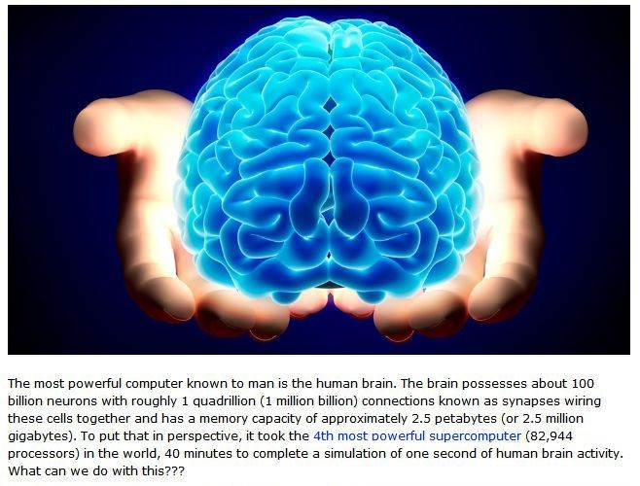
You Have a Very Smart Brain!
Presented by
Susan Close & Patricia Pain
10:30-12
Pulling Together: Equity in Education Conference
Greater Victoria School District 61
October 23, 2020

Slide 2



Land Acknowledgement
Musqueam
Kwikwetlem First Nation

Slide 3




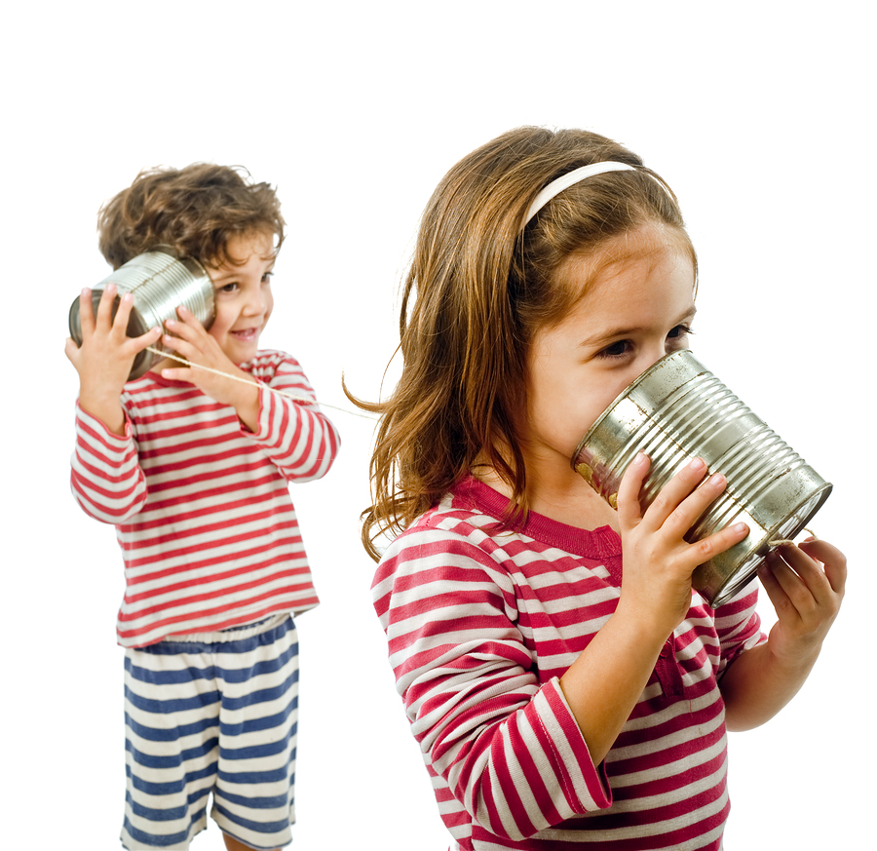



Chat Blast! ​
Type a response in the chat to each of these questions, but don't hit enter until I say go.​
​
We will hit enter at the same time and blast the chat with our responses!​
Who are you? ​
​
Where are you from?​
​
What is your role?​
​
One word to describe how you are feeling today...​

Slide 4



Who are we?
Susan Close
Patricia Pain

Slide 5

Keynote:
K
Denise Augustine
What struck y?
What struck you?
Type in your thoughts

Slide 6
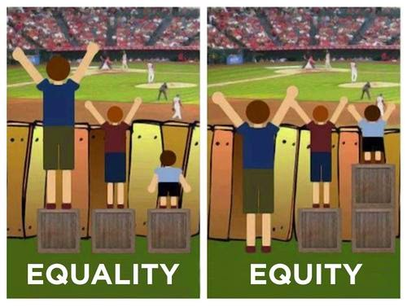
This Photo by Unknown Author is licensed under CC BY-SA-NC
Notes:
Diversity is being invited to the party
Inclusion is being invited to dance
Creating conditions for equal access

Slide 7

Shape of the session
Connecting
Reflecting on the keynote theme
Task for the session: How does SmartLearning achieve equity?
Your goals…
Hard questions
SmartLearning overview, drivers & findings
Processing
Lesson sequence: You have a very smart brain
Reflecting on the learning: What did you notice?
Transforming
Explain how SmartLearning achieves equity.
Reflecting
Find evidence of meeting your goals
Strengths you saw in the learning
Next steps…

Slide 8
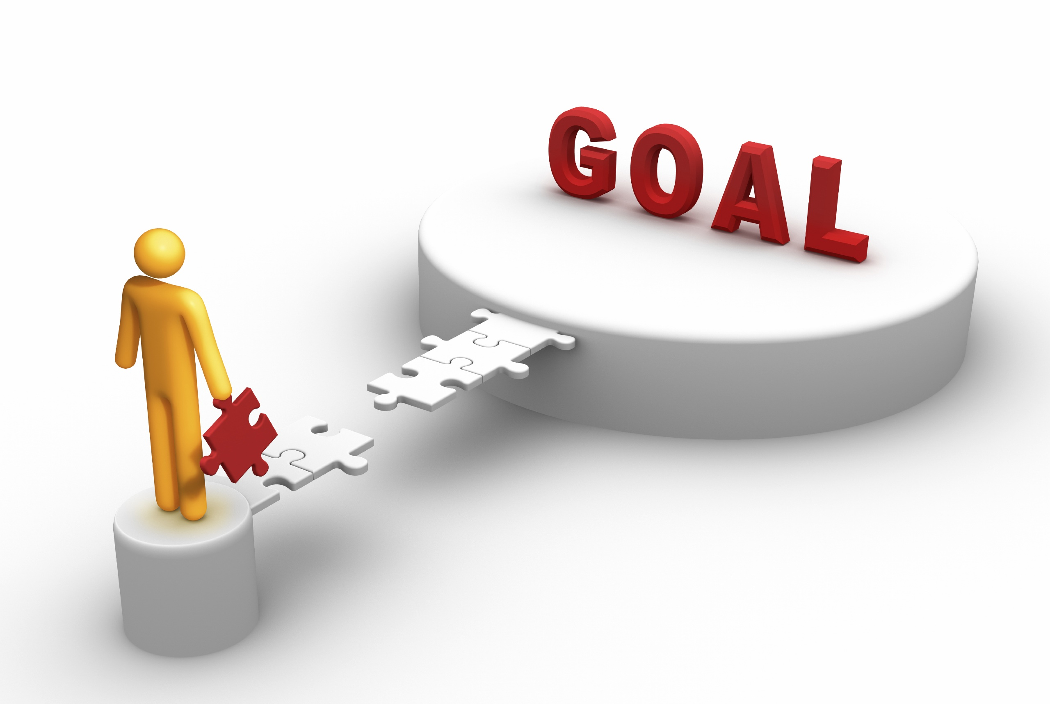
Your goals for the session…
Type them into the chat box

Slide 9
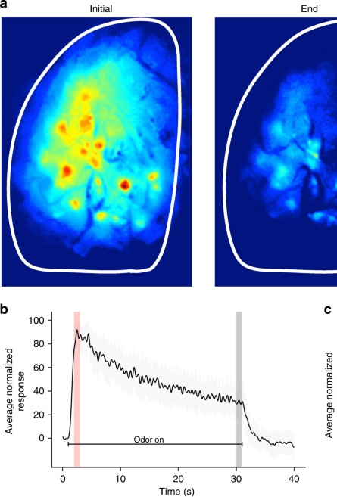
A very hard question:
How does a learning situation release the full mental resources of all learners and help them learn and retain complex skills? (Langer, 1997)
This Photo by Unknown Author is licensed under CC BY

Slide 10
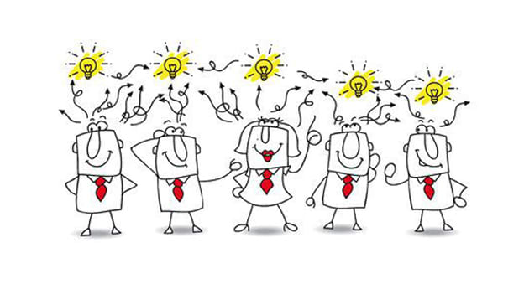
How do we harness collective intelligence?
While at any given moment our working memory remains small, quota for the total data we can pull through that narrow width becomes huge. This collective intelligence, the sum total of what everyone in a distributed group can contribute, promises maximal focus, the summation of what multiple eyes can notice (Goleman, 2013).

Slide 11
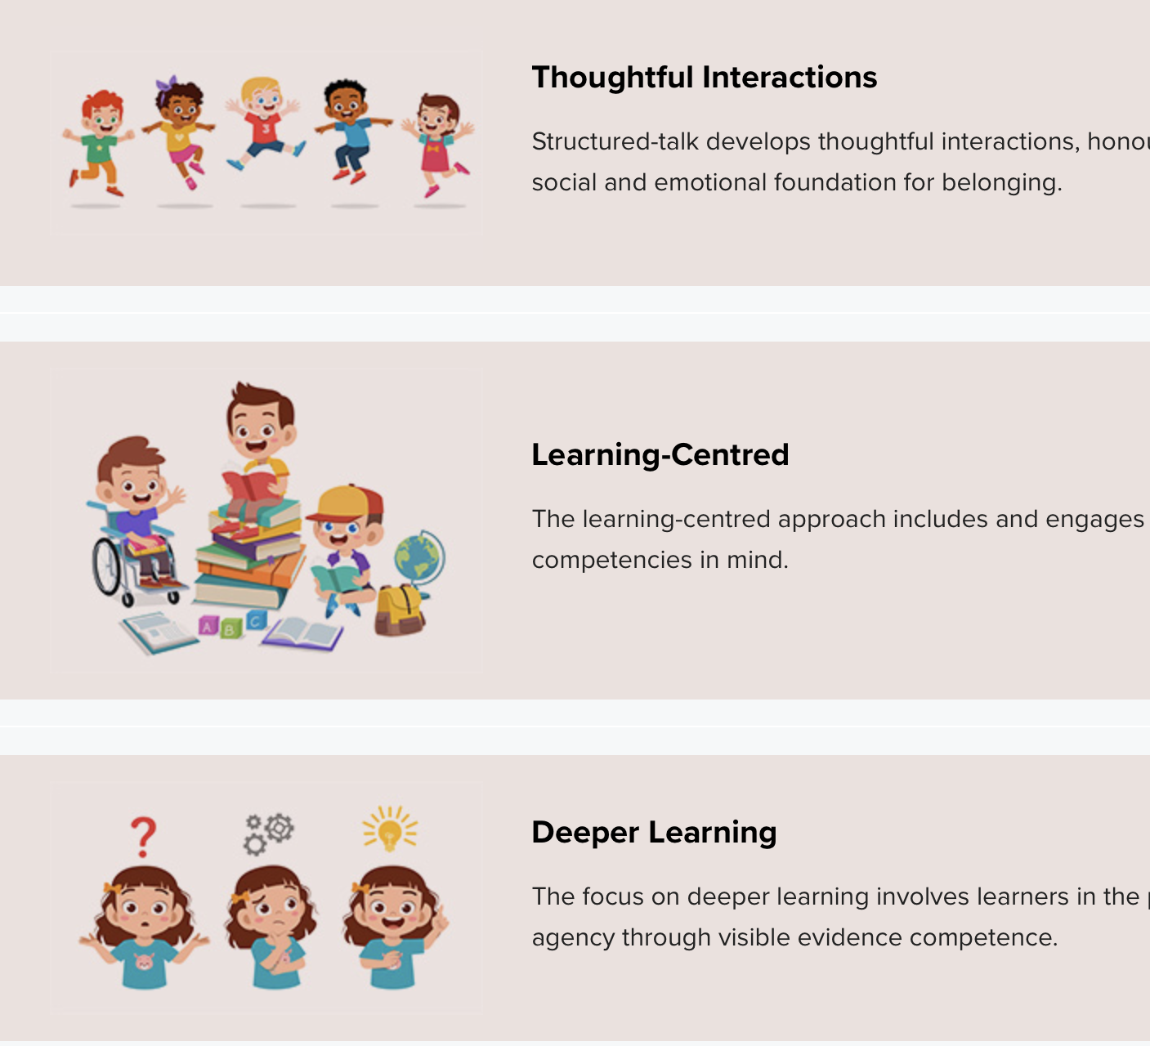
“…an inclusive, concept-based, learning-centred, and interactive approach to learning designed to develop agency alongside skills and competencies for deeper learning - in learners of all ages”.
Notes:
Susan
SmartLearning is an inclusive, concept-based, learning-centred, and interactive approach to learning designed to develop agency alongside skills and competencies for deeper learning - in learners of all ages.
Unpack words from definition – add framework
Thoughtful interactions
Learning-centered
Deeper Learning

Slide 12
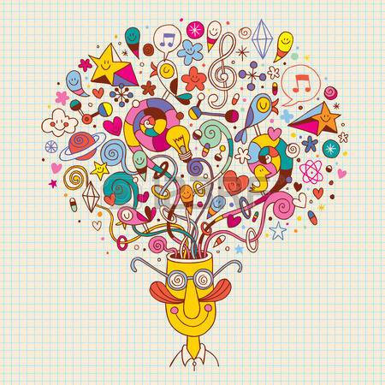

Think for a moment…
What does deeper learning mean to you?
This Photo by Unknown Author is licensed under CC BY-NC-ND

Slide 13
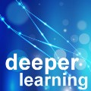
Students focus on the meaning of what they are learning, aim to develop their own understanding, relate ideas together and make connections with previous experiences, ask questions about what they are learning, discuss their ideas with others and compare different perspectives (Hattie & Donoghue, 2016).

Slide 14


Questions we ask:
Is what we’re doing giving us what we want?
How do we know?

Slide 15
Excerpt from the A▪S▪K-6to9 Skills & Competencies Continuum
Interpreting Big Idea, Message or Theme summarizing and synthesizing | Literal and concrete summary with direct or obvious connections to text or own experiences. Includes ‘first... next... finally’ for some aspects of the text (See ASK-3-5) | A generally accurate summary with clear, logical connections to text, own ideas and/or other selections, and supported with reasons and/or examples. Includes ‘problem, issue, solution’ for entire text. | A thoughtful synthesis, integrating text, own ideas and/or other selections, and supported with reasons/example/details. | A complex and evocative synthesis, integrating author’s and own knowledge; makes insightful, often subtle points among text, own ideas and/or other selections.
analyzing, interpreting | Relates the most obvious and concrete aspects of the selection to the reading or viewing experiences. | Generally accurate analysis and interpretation of theme/ideas, includes some inferences. | Analysis and interpretations of theme/ideas/elements show complexity; reveals deeper meaning; makes thoughtful inferences. | Specific and insightful analysis and interpretations of text, with connections to own ideas, other selections, or wider world.
drawing conclusions | Offers reactions with logical interpretations or obvious themes/ideas with minimal justification. A general obvious conclusion. | Logical conclusions. | Solid, clear conclusions. | Insightful, satisfying and often complex conclusions.

Slide 16
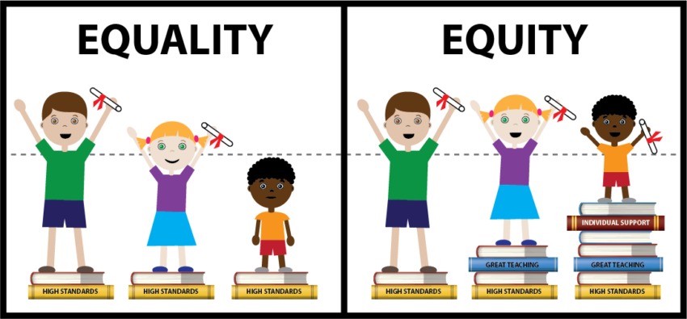

SmartLearning 2020
Deeper Learning
Building beliefs - agency
Setting s-t-r-e-t-c-h goals
Engaging in cognitive processes - SmartLearning tools - designed to develop competencies for deeper learning
Reflecting to find evidence of meeting goals; noticing strengths…
This Photo by Unknown Author is licensed under CC BY-NC

Slide 17
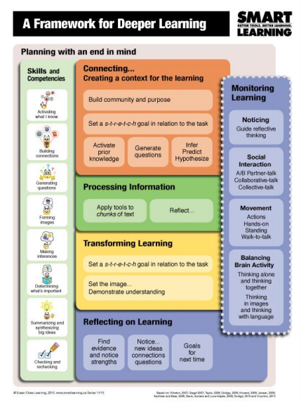
Notes:
Susan

Slide 18
Startling finding!
Teaching comprehension skills in isolation leads to no significant gains (Oakhill, 2019).
Then… what does?
Integrating skills with a purpose or task in mind…
End-tasks:
Open-ended:
Explain what the author wants you to understand; justify your thinking with evidence from the text.
Lesson task:
Think from a perspective to capture what is important…

Slide 19
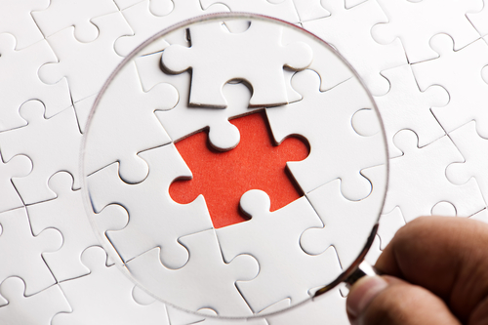
Important findings:
Taking on the perspective & feelings of others is one of the most profound contributors to deep reading. Empathy involves a whole feeling-thinking network that connects vision, language, and cognition with extensive subcortical networks (Wolf, 2018.)
Developing imagery while reading -- followed by drawing & generating a keyword gist-- allows the student to recall the imagery and helps the student express thinking with language… reading comprehension improved by 50%
(OECD, 2010; Bell, 2015).

Slide 20
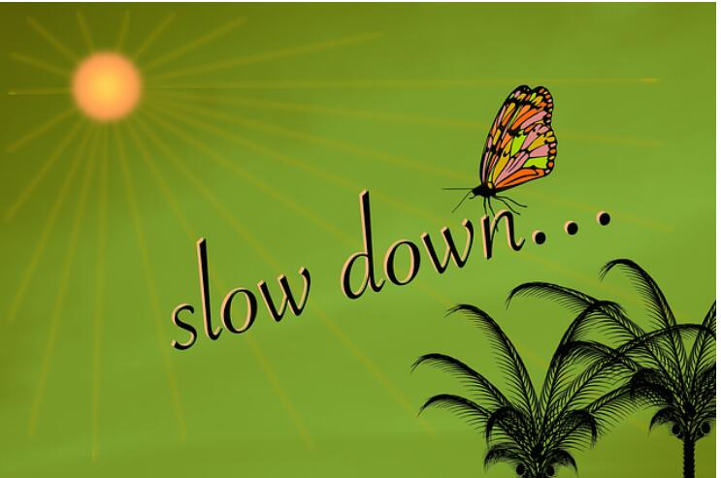

Festina lente: hasten slowly…
Slowing down to go deeper
inspired… an
acceleration of skills and achievement.

Slide 21
Building community & Purpose partners sitting side-to-side, distanced, or walk-to-talk
Structured A/B partner-talk
High challenge; low risk
I generate some thinking.
I explain and clarify my thinking as I’m talking.
I listen to notice similarities and differences, or to coach…
We share our collective thinking.
Hearing others’ thinking refines and extends my thinking.
___ and I think ___. We think this because ___.

Slide 22

Brain Bruising
Social pain – such that resulting from exclusion – activates the same brain regions as physical pain...
To the brain, social rejection is so meaningful that it hurts literally. (Eagleman, 2016)
Notes:
Tammy
Inventory
Brain research
Class agreements– how we are together (listening,
-- embed a little research about brain bruising
Criteria for powerful learning
Piper—build the sequence for them…

Slide 23
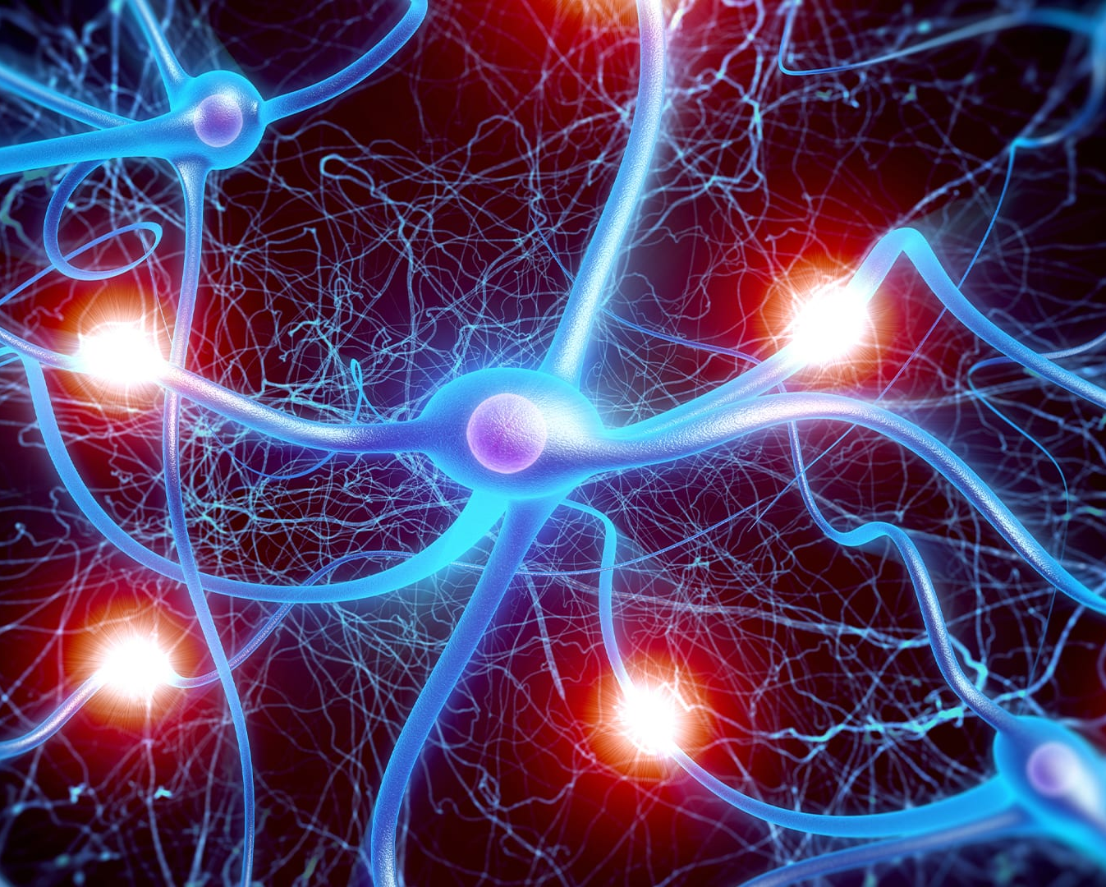

A Lesson sequence:
You have a very smart brain
This Photo by Unknown Author is licensed under CC BY-ND

Slide 24

A lesson sequence: You have a very smart brain
Designed to guide learners to understand more about how their brains process information as they learn SmartLearning routines, practices and processes
End task for the sequence:
Thinking like a neuroscientist, explain what you want people to know about the brain and learning?

Slide 25
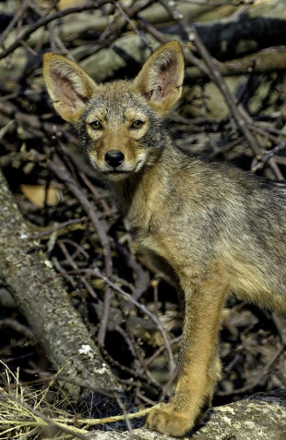
Tasks: What does a neuroscientist want you to know about the brain and learning?
TEXT: Novel: the adventures of a coyote
Lesson 1 Task:
Think like the mother coyote and write to send an image of what is important and how you are feeling about life at this moment in time.
Notice what makes a powerful image or picture in your brain.
This Photo by Unknown Author is licensed under CC BY-SA-NC

Slide 26
Tasks:
What does a neuroscientist want you to know about the brain and learning?
TEXT: a Read-aloud
Nell, the adventures of a coyote
Lesson 1 Task:
Think like the mother coyote and write to send an image of what is important and how you are feeling about life at this moment in time.
What are these tasks asking you to do?
Notice your thinking…

Slide 27
Awesome power in the brain…
Notes:
Susan

Slide 28
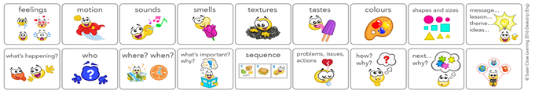
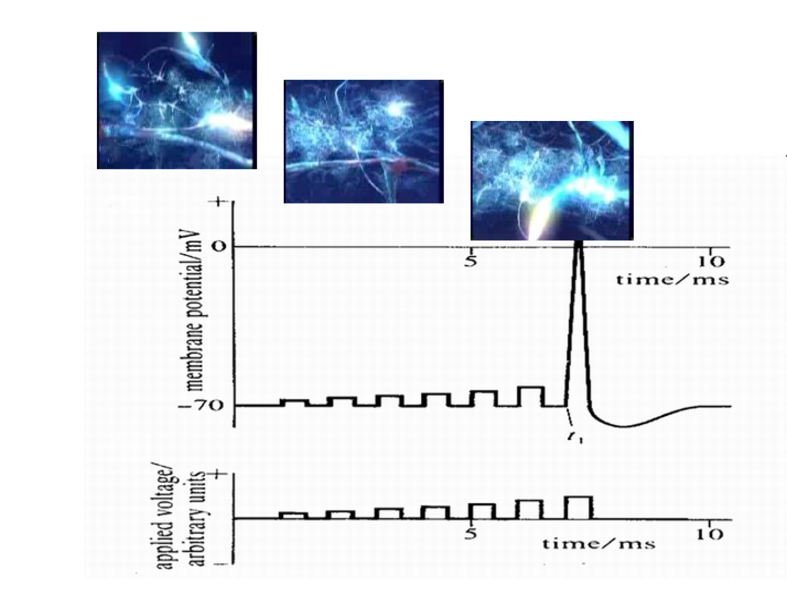
Neuro-plastic change occurs when a person pays close attention… noticing the smallest sensory distinctions builds brain maps… activating & strengthening networks of neurons
Notes:
Susan
Coaching Card

Slide 29
Goal: capture what is important
S-t-r-e-t-c-h goal:
Notice what makes a powerful picture or image in your thinking…

Slide 30
Activating prior knowledge & building background information
Tool: Gap Analysis
Notice images in your thinking:
Green shoots pushed through faded grass

Slide 31
Notice images in your thinking:
Green shoots pushed through faded grass
Stones in the furrows

Slide 32
Green shoots pushed through faded grass
Stones in the furrows
Babies the size of a small squirrel… blind

Slide 33
Green shoots pushed through faded grass
Stones in the furrows
Babies the size of a small squirrel… blind
Soft scuffling at the at the entrance to the den

Slide 34
Green shoots pushed through faded grass
Stones in the furrows
Babies the size of a small squirrel... blind
Soft scuffling at the at the entrance to the den
Bordering an overgrown field

Slide 35
Green shoots pushed through faded grass
Stones in the furrows
Babies the size of a small squirrel… blind
Soft scuffling at the at the entrance to the den
Bordering an overgrown field
Digging furiously with her forepaws

Slide 36

A↔B: partner-talk
What do you know?
A↔B: partner-talk
What don’t you know?

Slide 37

A↔B: generate a prediction for what life will be like for the mother coyote
___ and I predict the mother coyote’s life will be ___ . We think this because ___.

Slide 38
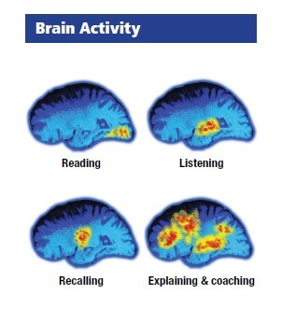
Noticing… about the brain and learning
What are you noticing about your thinking?
Notes:
Susan

Slide 39
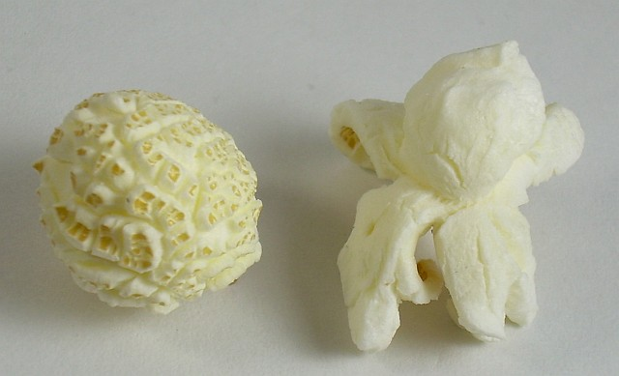
Questions: Wondering…
Tool: POPCORN
‘pop up’ to ask a
question

Slide 40
Setting a goal
Task: Think like the mother coyote to send an image of what life is like.
Choose two icons for focus on that will best help you achieve your goal.

Slide 41
Processing: Listening (viewing… reading) with a task and goal in mind
Tool: Idea-sketch▪tagline
See yourself as the mother coyote as I read a section of the story to you… notice images coming into your thinking…

Slide 42
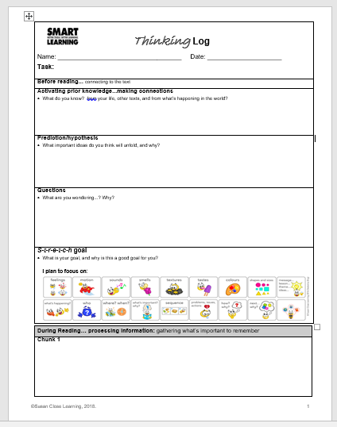
After listening and noticing thinking…
Idea-sketch as the mother coyote to send an image that shows what is important and how you are feeling about life…
Creating a visual that captures important ideas gives your brain a space to develop and refine your thinking. Observing and hearing other’s ideas extends your thinking.

Slide 43

Detective-walk to notice powerful images…
This Photo by Unknown Author is licensed under CC BY

Slide 44
Image Analysis: Partner Picture-talk
A: sends the sketched image…
I’m picturing…
B: listens, then coaches…
You could say more about…
(looks at picture) I noticed I pictured…
(looks at the coaching card strip and the picture)
I noticed I could picture more about…

Slide 45
Transforming:
Task: write as the coyote mother to send an image of what life is like for you and how you are feeling about it.
Tool: Task analysis
Tool: Set the image

Slide 46
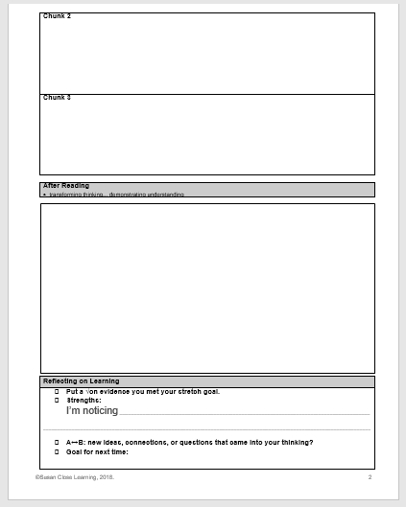

Slide 47

Reflecting
Put a √check on evidence you met your goal
What strengths did you notice in your learning?
A↔B: new ideas about coyotes, new connections, questions in your thinking
What makes a powerful image in your thinking: ZIPPER
Insight into one’s thoughts, or metacognition, is key to high achievement (Fleming, 2014)
ZIPPER: to hear ideas… introduce kinesthetic actions

Slide 48
My homework:
Find powerful images in the students’ work – in the Idea-sketches, the Taglines… and the writing.
Connecting for the next day:
Use examples to build a T-chart for what makes a powerful image
Quality on the left→Example on the right
Learners use the criteria to set stretch goals
Identify icons to focus on to help them reach goals.

Slide 49
Think for a moment…
Is what we’re doing giving us what we want?
How do we know?

Slide 50
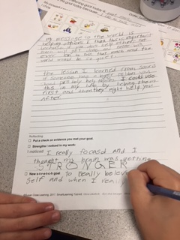
Is what we are doing giving us what we want?
Reflecting... on Reading/Viewing & Responding | (With support*) refers to class generated criteria and/or stretch goal/s to identify some evidence of meeting goal. | Refers to class generated criteria and stretch goal to identify some specific evidence of meeting a stretch goal. | Refers to class generated criteria and stretch goal to identify detailed evidence of meeting a stretch goal for reading and responding. | Refers to class generated criteria and stretch goal to identify significant or insightful evidence of meeting a personal stretch goal for reading and responding.
 | With prompting*, identifies some evidence of strength in reading and responding. | Uses class generated criteria and some self-knowledge to identify strengths in reading and responding. | Uses class generated criteria and self-knowledge to identify detailed evidence of personal strengths in reading. | Uses class generated criteria and well-considered self-knowledge to identify significant personal strengths in reading.
 | May attempt to identify and explain a plan for achieving the goal/s. | Identifies a new s-t-r-e-t-c-h goal for reading and responding, with a limited explanation of why the goal is appropriate. | Identifies a relevant new s-t-r-e-t-c-h goal for reading and explains with some detail why the goal is personally appropriate. | Identifies a well-considered new goal. Explains why the s-t-r-e-t-c-h goal is personally appropriate, with a deeply insightful reflective statement.

Slide 51
Task:
How does SmartLearning 2020 achieve equity?
This Photo by Unknown Author is licensed under CC BY-NC
What did you notice about the learning?

Slide 52
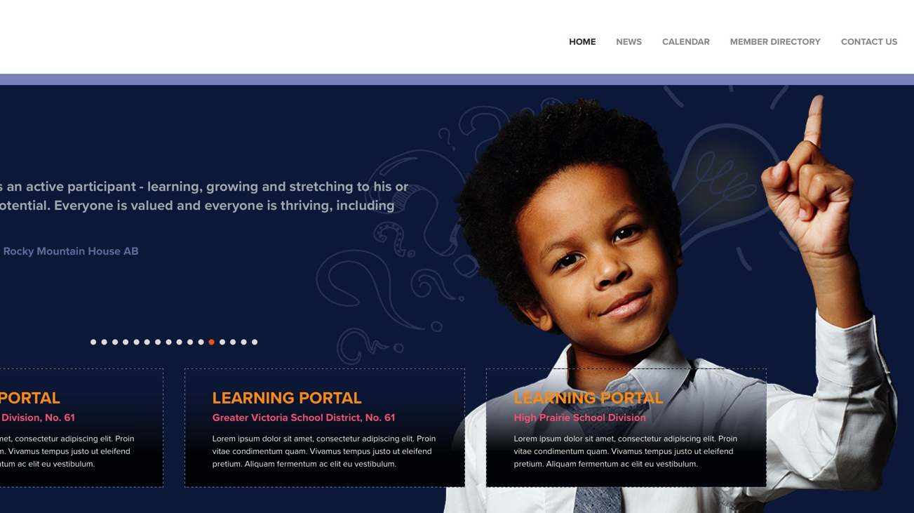
Ways to support you www.smartlearning.ca click: Events
One suggestion:
Team or small group coaching…
with access to sequences, tools and materials

Slide 53
Next session: 1-2:30

